Slide 1
Google Drive/Google ClassroomGetting Started with Google!
In-Service
October 8, 2014
Presented by: Layla Lyons

Slide 2
What is Google Drive & Google Classroom?

Slide 3
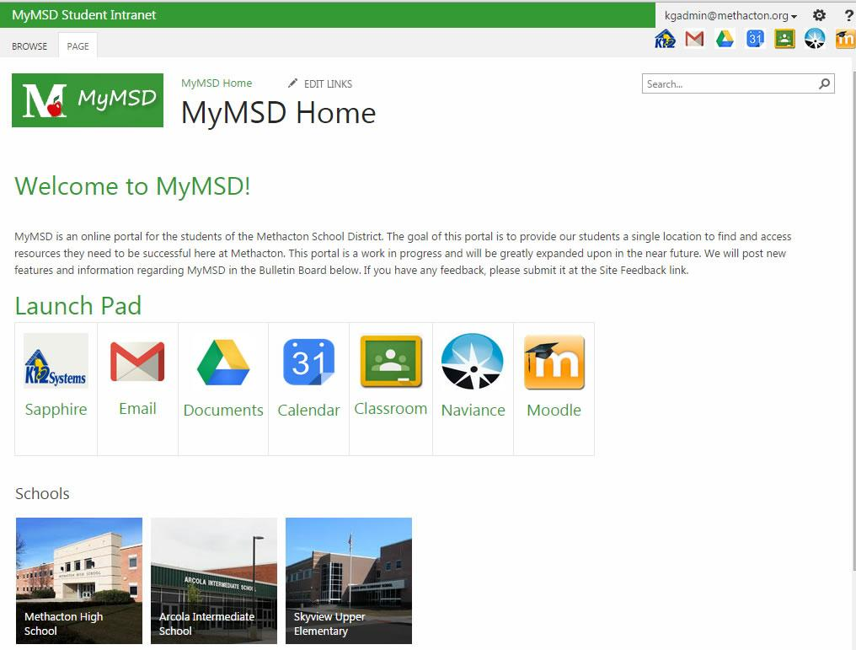

Slide 4
Google Drive Manual Workflow
Naming Conventions
Organization
Time

Slide 5
Why Google Classroom
Workflow Automation
Unified view for Students & Teachers
Cross Platform
Simplifies Distribution & Collection
Due Dates & Turn in Process
Beyond Google: Video, Screencasts, PDFs, etc...

Slide 6
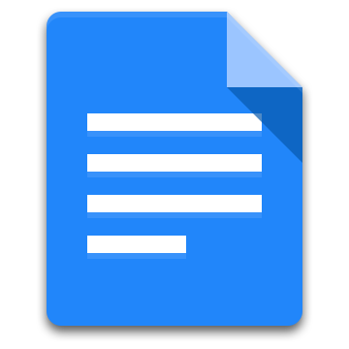
Google Drive:
Organization & Management
Students Turn in
Individual Documents
& Teacher Organizes
in Assignment Folders
Teacher Drags Assignments into an Assignment Folder

Slide 7
Google Drive:
Organization & Management
Students Create
"Turn In" Folder
Share with Teacher
(Editing Access)
Teacher Drags Student
Folders into 1 Folder
for that Class

Slide 8
Google Drive:
Organization & Management
Student
Student
Student
Student
Student
Student
Student
Student
Students
Students
Teacher Creates
"Resources" Folder
& shares with students
(View Access)

Slide 9
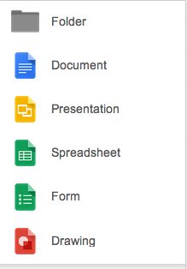
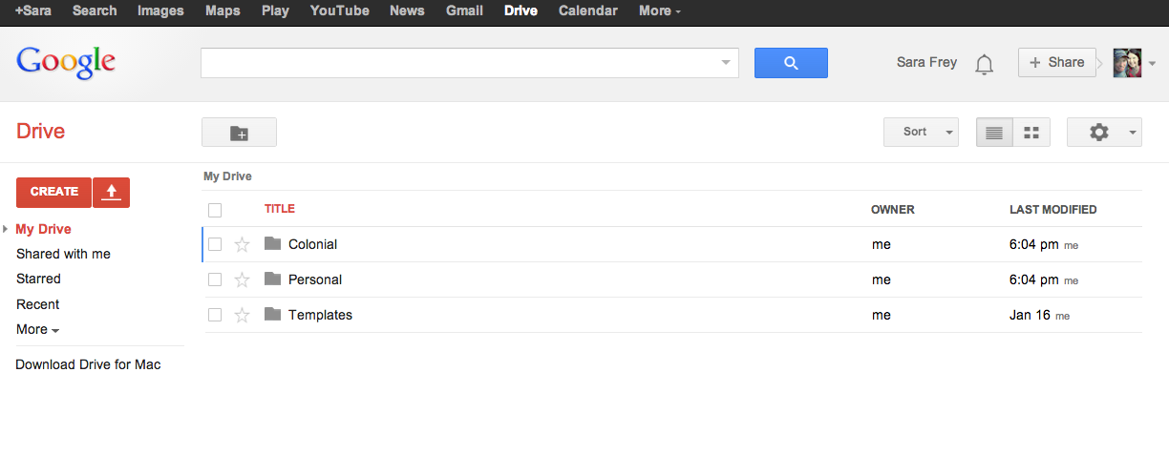
Create a new document
Similar to:
Word
PowerPoint
Excel
Make a quiz or a survey
Create a new folder
Upload documents from your computer
Documents created by others that have been shared with you will automatically appear here.

Slide 10
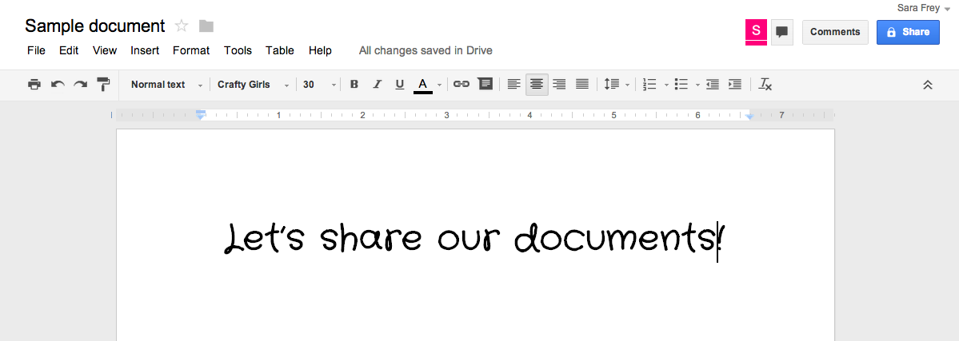
If others are looking at the document at the same time you are, you’ll see little symbols here. Click on the speech bubble to chat.
Click here to leave comments for others.
Highlight the text, then click on Comments to add feedback and questions. (See below.)

Slide 11
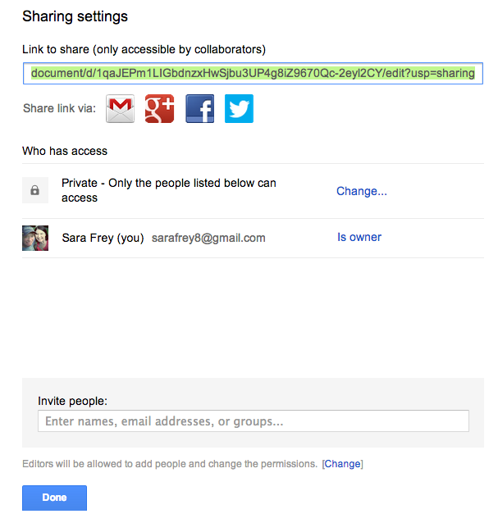
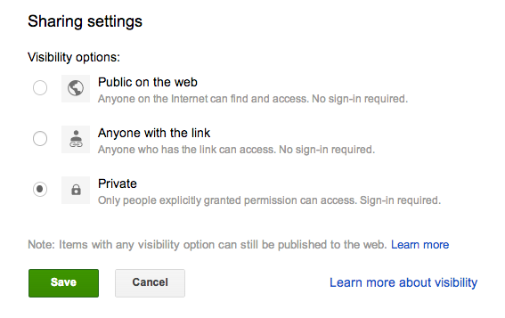
Two places to find the Share function
Click here to share the document.
You probably don’t want to open it up to just anyone.
Let’s choose this one.

Slide 12
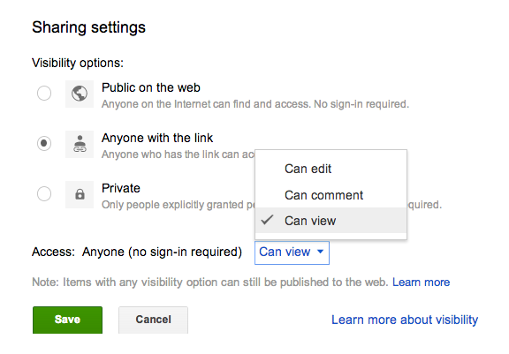
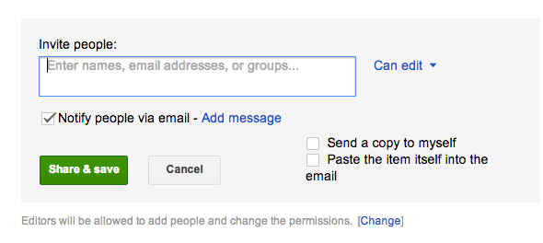
They can see it, leave comments, and make changes.
They can see it, and leave comments.
They can see it, but can’t leave comments or make changes.
Click on the box to view email options.
You can send the link directly to people, and add a personal message about the document.

Slide 13
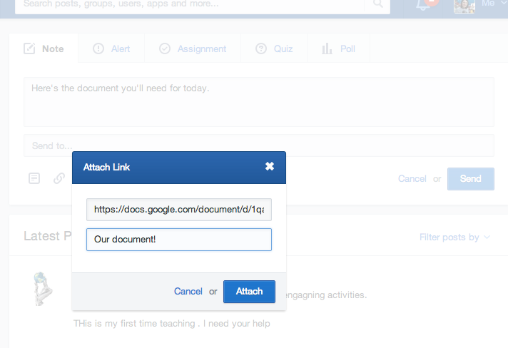
You can copy and paste this link anywhere, including on Edmodo.
In note, alert, or assignment, click the link icon.
Paste in the web address.
Create a title or description for the link.
Attach, and you’re all finished!

Slide 14
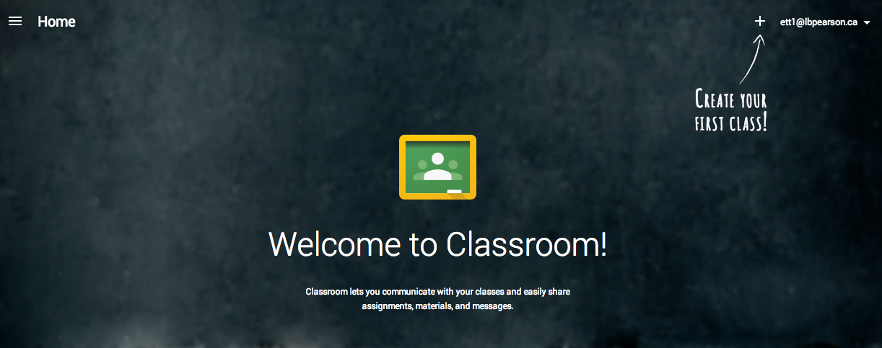
classroom.google.com
When first logging into Classroom, DO NOT click Student
Help Page to Change Account Status

Slide 15
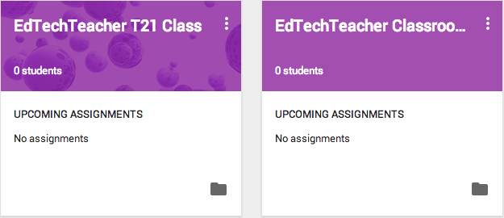
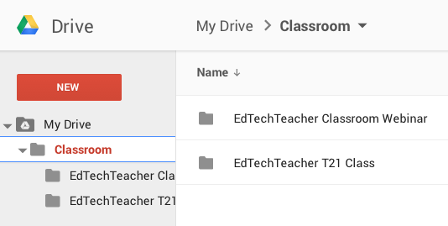
Google Drive Syncing

Slide 16
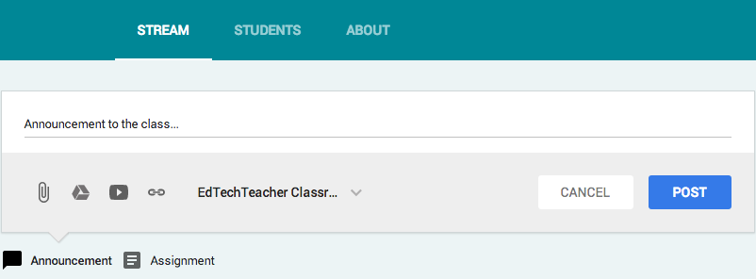
Simplified Interface

Slide 17
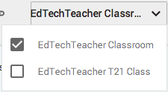
Cross Class Distribution

Slide 18
Assignment Types
Google Product (Student Generated)
Google Product (Teacher Generated)
Non-Google Product
(Video, Screencast, Link, PDF)

Slide 19
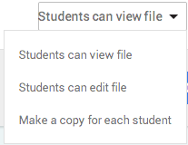
Assignment Distribution Options

Slide 20
Live Demonstration of Classroom

Slide 21
iPads & Google Classroom
Google Doc Created by Teacher - Student is automatically redirected to the Google Docs App to write
Google Doc Created by Student - Student is redirected to Google Docs App & file is named according to assignment
Annotated PDFs - If file is uploaded to Google Drive, students can selected the annotated PDF to turn in.
NOTE - File will not be auto named by Classroom
Video - If students upload or export video to Google Drive, it can be uploaded to Classroom & turned in.
NOTE - Video file will not be auto named by Classroom

Slide 22
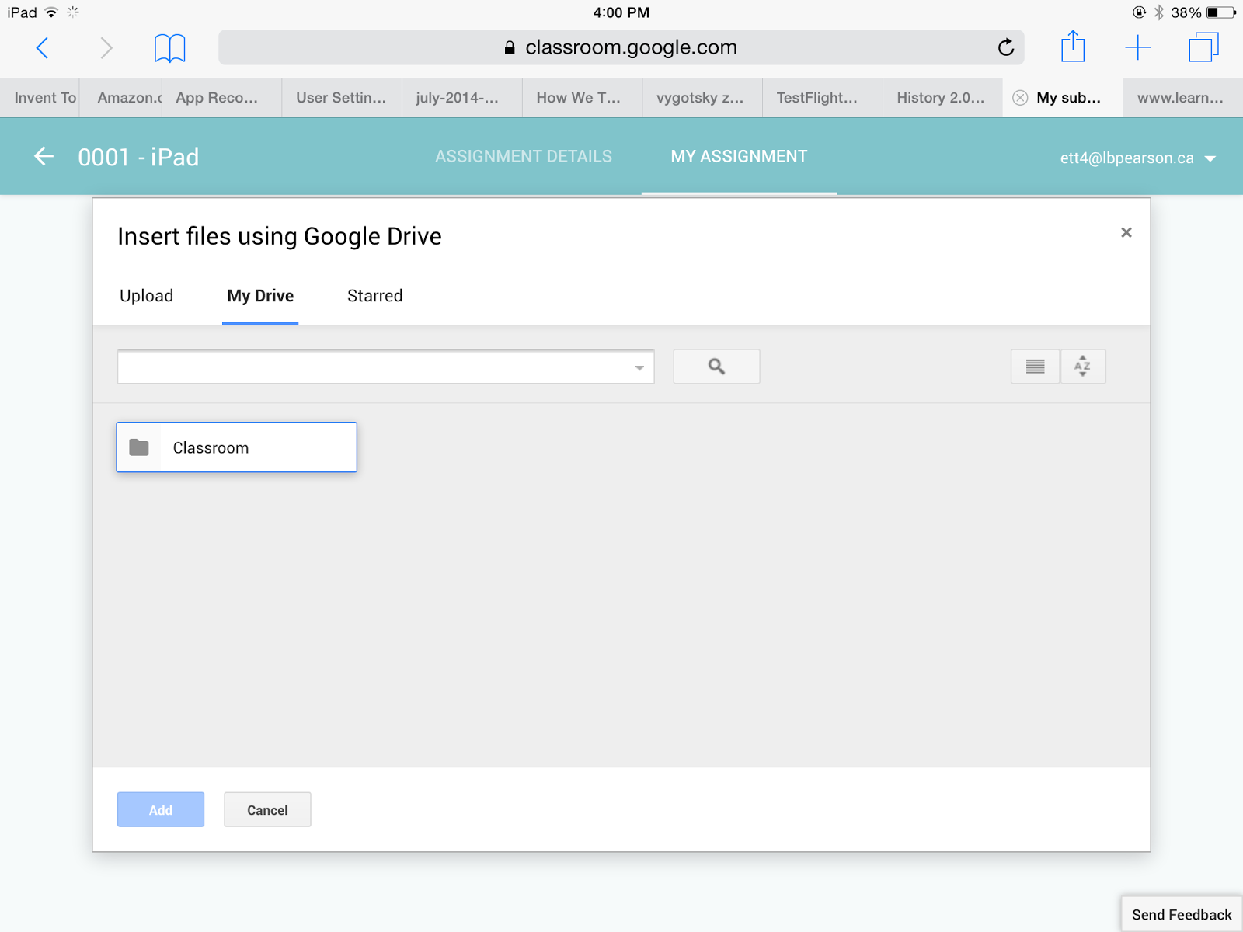
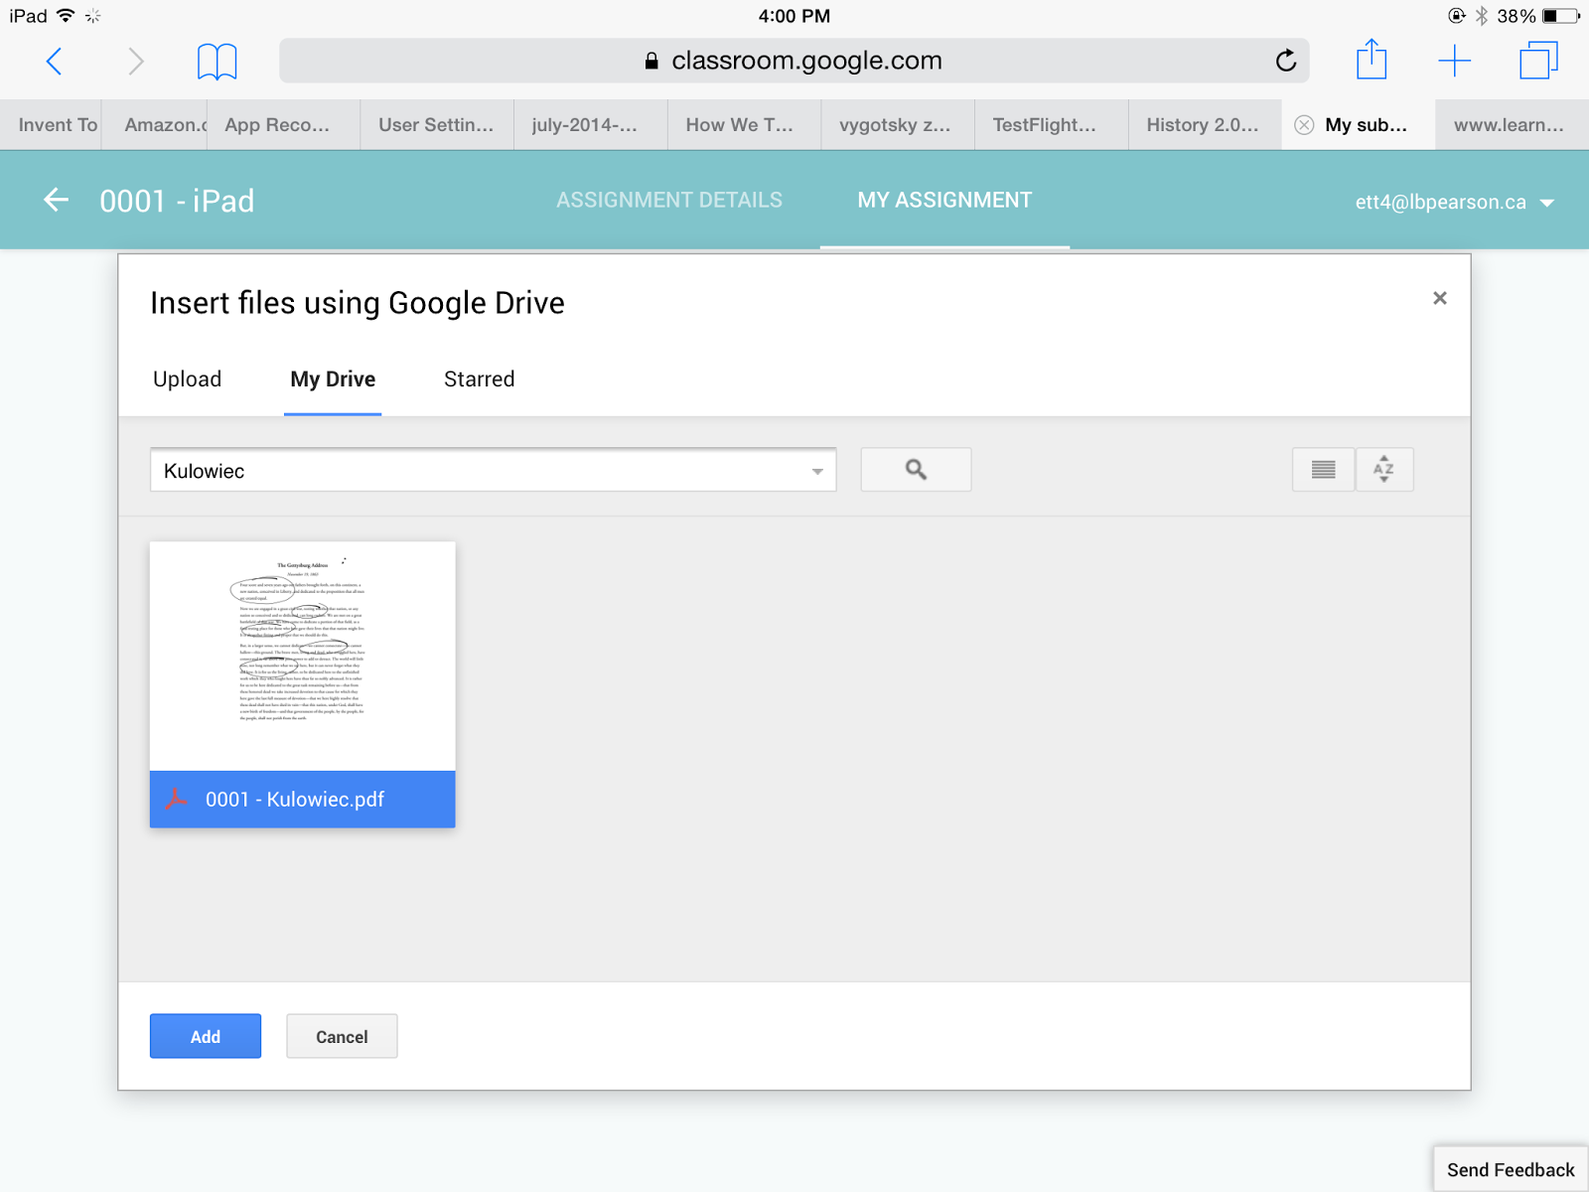
iPads & Classroom:
Selecting Work from Drive

Slide 23
Helpful Tips with Classroom
Assignment Naming = Google Drive Organization
Google Slides - Whole Class Creation
Google Spreadsheets -
Class Data Entry / Discussion / Reflection
Link / YouTube Distribution - Multiple Links per assignment
Differentiate - Multiple Documents / Files per assignment.
Class Resources Page - Centralize Frequently Used Files

Slide 24
Additional Google Classroom Resources
Introduction to Google Classroom (Edudemic)
How to Integrate iPads with Google Classroom (Edudemic)
5 Potential Mistakes in Google Classroom - Teacher Tech
Alice Keeler
20 Things You Can Do With Google Classroom - Teacher Tech
Alice Keeler
Google Classroom Help Page (Google)
Resources from: http://edtechteacher.org/14Fall6/
S. Frey/Colonial School District

